Slide 1
Lecture 4
Data Modeling Using the Entity-Relationship (ER) Model

Slide 2
Chapter Outline
Overview of Database Design Process
Example Database Application (COMPANY)
ER Model Concepts
Entities and Attributes
Entity Types, Value Sets, and Key Attributes
Relationships and Relationship Types
Weak Entity Types
Roles and Attributes in Relationship Types
ER Diagrams - Notation
ER Diagram for COMPANY Schema

Slide 3
Data models
Conceptual (high-level, semantic) data models: Provide concepts that are close to the way many users perceive data. (Also called entity-based or object-based data models.)
Physical (low-level, internal) data models: Provide concepts that describe details of how data is stored in the computer.

Slide 4
Overview of Database Design Process
Two main activities:
Database design
Applications design
Lecture Focus is on database design
To design the conceptual schema for a database application
Applications design focuses on the programs and interfaces that access the database
Generally considered part of software engineering

Slide 5
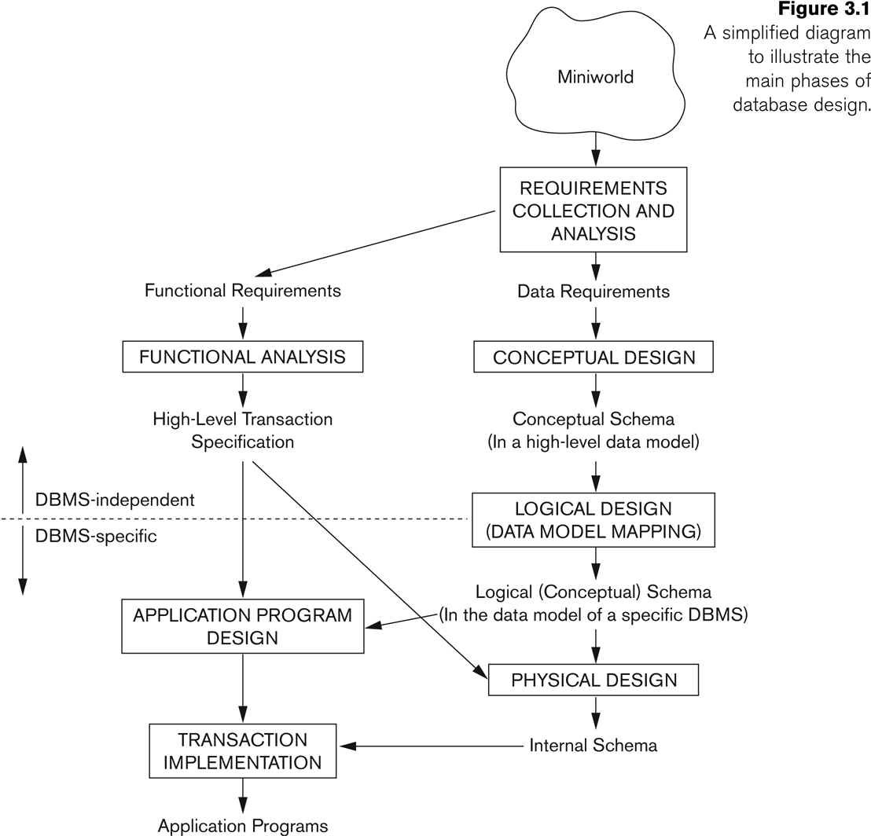
Overview of Database Design Process

Slide 6
Example COMPANY Database
We need to create a database schema design based on the following (simplified) requirements of the COMPANY Database:
The company is organized into DEPARTMENTs. Each department has a name, number and an employee who manages the department. We keep track of the start date of the department manager. A department may have several locations.
Each department controls a number of PROJECTs. Each project has a unique name, unique number and is located at a single location.

Slide 7
Example COMPANY Database (Contd.)
We store each EMPLOYEE’s social security number, address, salary, sex, and birthdate.
Each employee works for one department but may work on several projects.
We keep track of the number of hours per week that an employee currently works on each project.
We also keep track of the direct supervisor of each employee.
Each employee may have a number of DEPENDENTs.
For each dependent, we keep track of their name, sex, birthdate, and relationship to the employee.

Slide 8
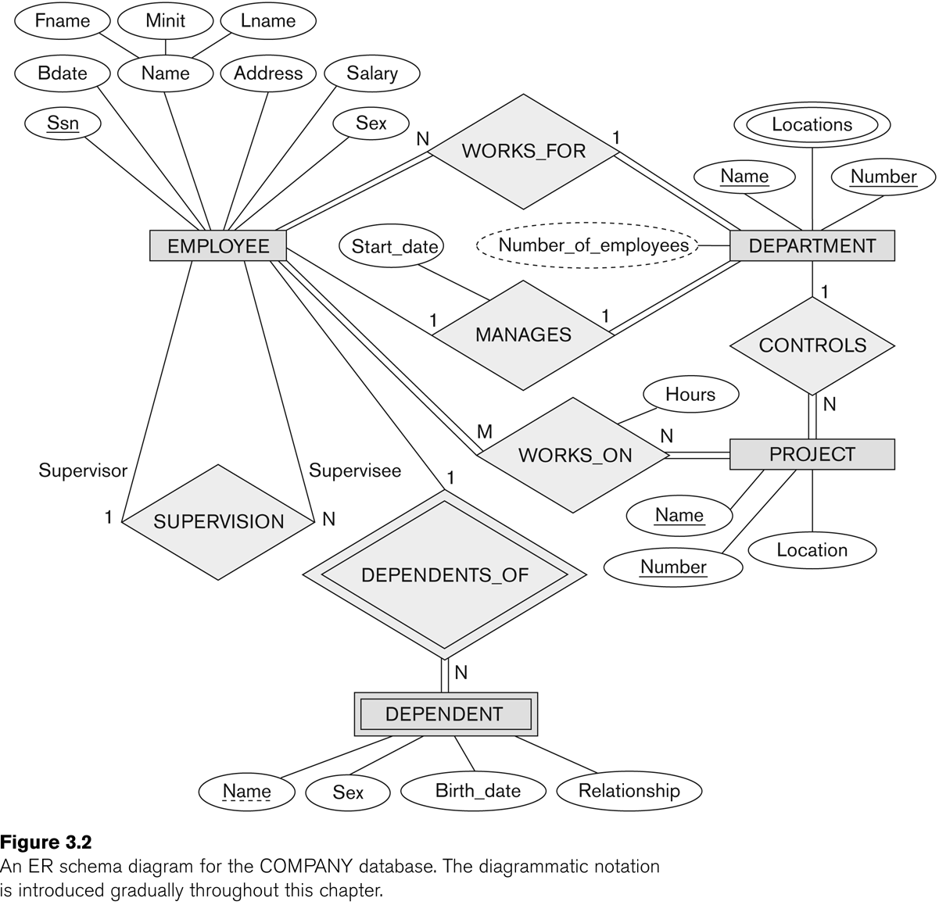

Slide 9
ER Model Concepts
Entities and Attributes
Entities are specific objects or things in the mini-world that are represented in the database.
For example the EMPLOYEE John Smith, the Research DEPARTMENT, the ProductX PROJECT
Attributes are properties used to describe an entity.
For example an EMPLOYEE entity may have the attributes Name, SSN, Address, Sex, BirthDate
A specific entity will have a value for each of its attributes.
For example a specific employee entity may have Name='John Smith', SSN='123456789', Address ='731, Fondren, Houston, TX', Sex='M', BirthDate='09-JAN-55‘
Each attribute has a value set (or data type) associated with it – e.g. integer, string, subrange, enumerated type, …

Slide 10
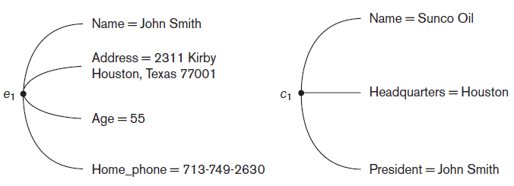
Entities

Slide 11
Types of Attributes (1)
Simple
Each entity has a single atomic value for the attribute. For example, SSN or Sex.
Composite
The attribute may be composed of several components. For example:
Address(Apt#, House#, Street, City, State, ZipCode, Country), or
Name(FirstName, MiddleName, LastName).
Composition may form a hierarchy where some components are themselves composite.
Multi-valued
An entity may have multiple values for that attribute. For example, Color of a CAR or PreviousDegrees of a STUDENT.
Denoted as {Color} or {PreviousDegrees}.

Slide 13
Types of Attributes (2)-Complex attribute
In general, composite and multi-valued attributes may be nested arbitrarily to any number of levels, although this is rare.
For example, PreviousDegrees of a STUDENT is a composite multi-valued attribute denoted by {PreviousDegrees (College, Year, Degree, Field)}
Multiple PreviousDegrees values can exist
Each has four subcomponent attributes:
College, Year, Degree, Field
Derived Attribute

Slide 14
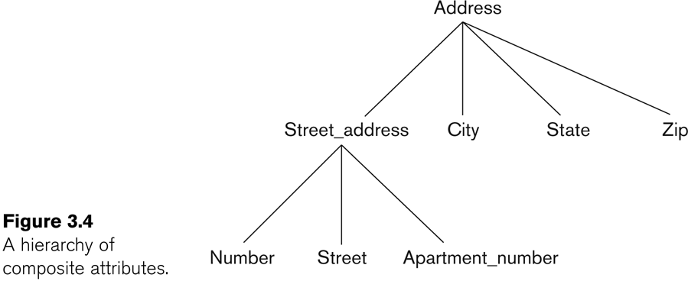
Example of a composite attribute

Slide 15
Entity Types and Key Attributes (1)
Entities with the same basic attributes are grouped or typed into an entity type.
For example, the entity type EMPLOYEE and PROJECT.
An attribute of an entity type for which each entity must have a unique value is called a key attribute of the entity type.
For example, SSN of EMPLOYEE.

Slide 16
Entity Types and Key Attributes (2)
A key attribute may be composite.
VehicleTagNumber is a key of the CAR entity type with components (Number, State).
An entity type may have more than one key.
The CAR entity type may have two keys:
VehicleIdentificationNumber (popularly called VIN)
VehicleTagNumber (Number, State), aka license plate number.
Each key is underlined

Slide 17
Displaying an Entity type
In ER diagrams, an entity type is displayed in a rectangular box
Attributes are displayed in ovals
Each attribute is connected to its entity type
Components of a composite attribute are connected to the oval representing the composite attribute
Each key attribute is underlined
Multivalued attributes displayed in double ovals
See CAR example on next slide

Slide 18
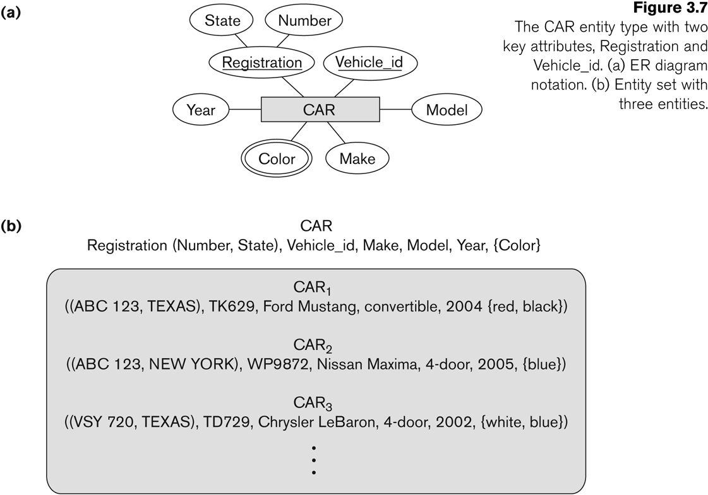
Entity Type CAR with two keys and a corresponding Entity Set

Slide 19
Entity Set
Each entity type will have a collection of entities stored in the database
Called the entity set
Previous slide shows three CAR entity instances in the entity set for CAR
Same name (CAR) used to refer to both the entity type and the entity set
Entity set is the current state of the entities of that type that are stored in the database

Slide 20
Initial Design of Entity Types for the COMPANY Database Schema
Based on the requirements, we can identify four initial entity types in the COMPANY database:
DEPARTMENT
PROJECT
EMPLOYEE
DEPENDENT
Their initial design is shown on the following slide
The initial attributes shown are derived from the requirements description

Slide 21
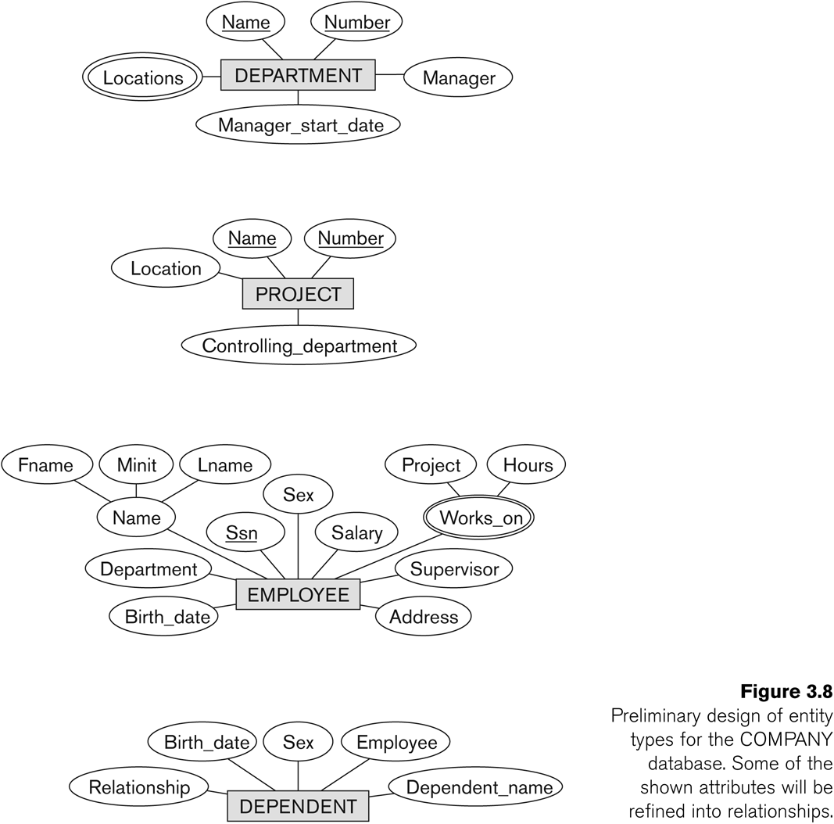
Initial Design of Entity Types: EMPLOYEE, DEPARTMENT, PROJECT, DEPENDENT

Slide 22
Refining the initial design by introducing relationships
The initial design is typically not complete
Some aspects in the requirements will be represented as relationships
ER model has three main concepts:
Entities (and their entity types and entity sets)
Attributes (simple, composite, multivalued)
Relationships (and their relationship types and relationship sets)
We introduce relationship concepts next

Slide 23
Relationships and Relationship Types (1)
Whenever an Attribute of one entity type refers to another entity type.
A relationship relates two or more distinct entities with a specific meaning.
For example, EMPLOYEE John Smith works on the ProductX PROJECT, or EMPLOYEE Franklin Wong manages the Research DEPARTMENT.
Relationships of the same type are grouped or typed into a relationship type.
For example, the WORKS_ON relationship type in which EMPLOYEEs and PROJECTs participate, or the MANAGES relationship type in which EMPLOYEEs and DEPARTMENTs participate.
The degree of a relationship type is the number of participating entity types.
Both MANAGES and WORKS_ON are binary relationships.

Slide 24
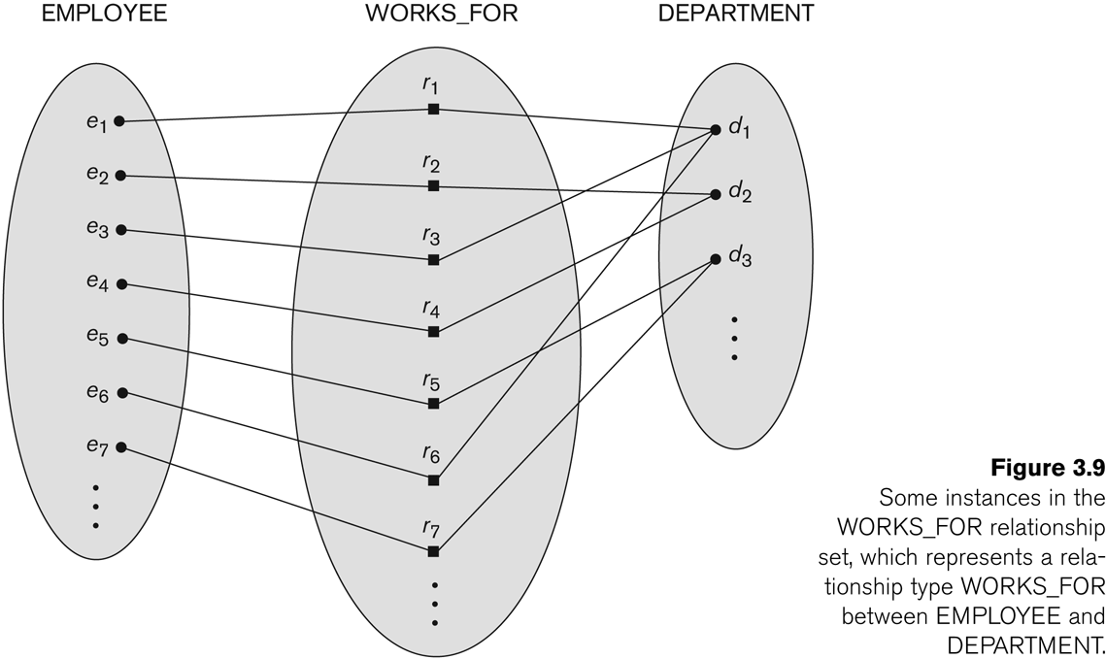
Relationship instances of the WORKS_FOR

Slide 25
Relationship type vs. relationship set (1)
Relationship Type:
Is the schema description of a relationship
Identifies the relationship name and the participating entity types
Also identifies certain relationship constraints
Relationship Set:
The current set of relationship instances represented in the database
The current state of a relationship type

Slide 26
Relationship type vs. relationship set (2)
In ER diagrams, we represent the relationship type as follows:
Diamond-shaped box is used to display a relationship type
Connected to the participating entity types via straight lines

Slide 27
Refining the COMPANY database schema by introducing relationships
By examining the requirements, six relationship types are identified
All are binary relationships( degree 2)
Listed below with their participating entity types:
WORKS_FOR (between EMPLOYEE, DEPARTMENT)
MANAGES (also between EMPLOYEE, DEPARTMENT)
CONTROLS (between DEPARTMENT, PROJECT)
WORKS_ON (between EMPLOYEE, PROJECT)
SUPERVISION (between EMPLOYEE (as subordinate), EMPLOYEE (as supervisor))
DEPENDENTS_OF (between EMPLOYEE, DEPENDENT)

Slide 28
ER DIAGRAM – Relationship Types are: WORKS_FOR, MANAGES, WORKS_ON, CONTROLS, SUPERVISION, DEPENDENTS_OF

Slide 29
Discussion on Relationship Types
In the refined design, some attributes from the initial entity types are refined into relationships:
Manager of DEPARTMENT -> MANAGES
Works_on of EMPLOYEE -> WORKS_ON
Department of EMPLOYEE -> WORKS_FOR
etc
In general, more than one relationship type can exist between the same participating entity types
MANAGES and WORKS_FOR are distinct relationship types between EMPLOYEE and DEPARTMENT
Different meanings and different relationship instances.

Slide 30
Recursive Relationship Type
An relationship type whose with the same participating entity type in distinct roles
Example: the SUPERVISION relationship
EMPLOYEE participates twice in two distinct roles:
supervisor (or boss) role
supervisee (or subordinate) role
Each relationship instance relates two distinct EMPLOYEE entities:
One employee in supervisor role
One employee in supervisee role

Slide 31
Weak Entity Types
An entity that does not have a key attribute
A weak entity must participate in an identifying relationship type with an owner or identifying entity type
Entities are identified by the combination of:
A partial key of the weak entity type
The particular entity they are related to in the identifying entity type
Example:
A DEPENDENT entity is identified by the dependent’s first name, and the specific EMPLOYEE with whom the dependent is related
Name of DEPENDENT is the partial key
DEPENDENT is a weak entity type
EMPLOYEE is its identifying entity type via the identifying relationship type DEPENDENT_OF

Slide 32
Constraints on Relationships
Constraints on Relationship Types
(Also known as ratio constraints)
Cardinality Ratio (specifies maximum participation)
One-to-one (1:1)
One-to-many (1:N) or Many-to-one (N:1)
Many-to-many (M:N)
Existence Dependency Constraint (specifies minimum participation) (also called participation constraint)
zero (optional participation, not existence-dependent)
one or more (mandatory participation, existence-dependent)
Double line and single line

Slide 33
Many-to-one (N:1) Relationship

Slide 34
Many-to-one (N:1) Relationship

Slide 35
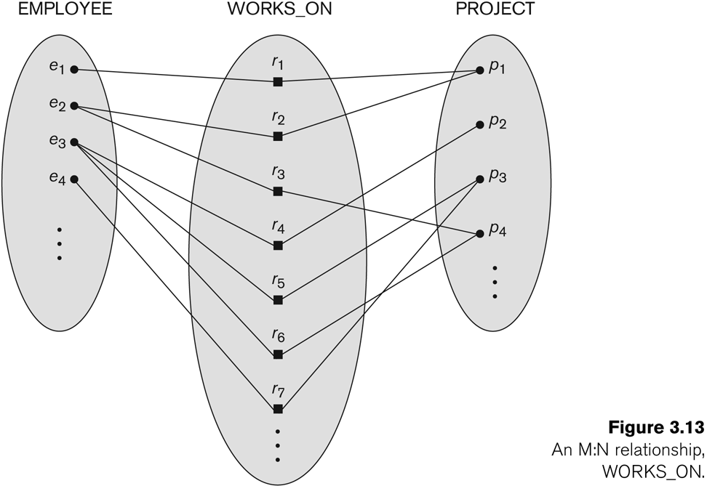
Many-to-many (M:N) Relationship

Slide 36
Displaying a recursive relationship
In a recursive relationship type.
Both participations are same entity type in different roles.
For example, SUPERVISION relationships between EMPLOYEE (in role of supervisor or boss) and (another) EMPLOYEE (in role of subordinate or worker).
In following figure, first role participation labeled with 1 and second role participation labeled with 2.
In ER diagram, need to display role names to distinguish participations.

Slide 37
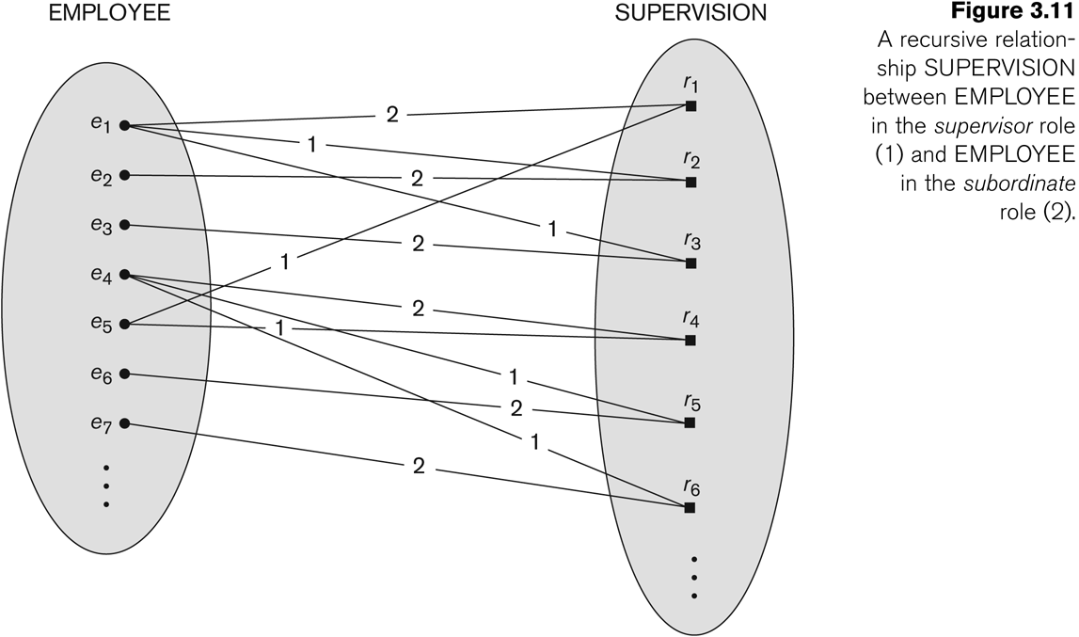
A Recursive Relationship Supervision`

Slide 38
Summary

